Slide 1
Introduction to C
CS 580U

Slide 2
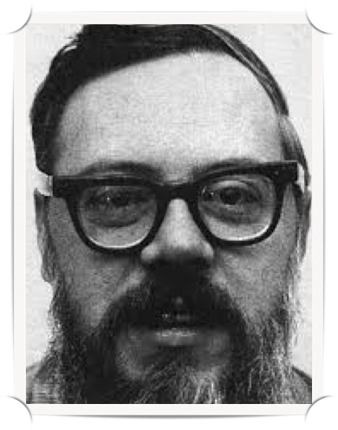
History of C
Created by Dennis Ritchie at Bell Laboratories in the early 1970s
Developed for Unix, traditionally used for systems programming
ANSI C - Standardized in 1989 by ANSI (American National Standards Institute)
What C offers
Portability (kind of)
Performance (still today)

Slide 3
Why C?
Direct relationship with Assembly
Concise Syntax
Portability
Type Checking

Slide 4
Compilation: Translating High Level Languages
Interpretation
interpreter = program that executes program statements generally one line/command at a time with limited preprocessing
easy to debug, make changes
languages: Ruby, Python, Java
Compilation
translates statements into machine language but does not execute, allowing for optimization
change requires recompilation
languages: C, C++, Java

Slide 5
Compilation OR Interpretation
Consider the following algorithm:
X=W+W Y=X+X Z=Y+Y Print Z to screen.
If interpreting, how many arithmetic operations occur?
If compiling, we can analyze the entire program and possibly reduce the number of operations. Can we simplify the above algorithm to use a single arithmetic operation?
Z = W*8

Slide 6
Compilation
C is a compiled language
A program, run from the console, reads the code you write and converts it into machine language that can be read by the computer
A compiled language gets converted all in one go
The Good:
Optimization
Many errors are found during ‘compilation’, it’s much faster
The Bad:
requires more static programming techniques

Slide 7
Compiler
We will use the GNU compiler, gcc
gcc is a program, called from the command line, that compiles source code
Syntax:
gcc <myfile>
produces an executable called a.out
Example
gcc source.c
Run your program with ./
./a.out

Slide 8
Libraries
Pre-written libraries eliminate (some) code repetition
Essentially, you can load someone else code into your program and it’s not even cheating
Abstract away some complexity
Such as memory mapped IO
Simplifies code
Load libraries with #include <library>
#include <stdio.h>

Slide 9
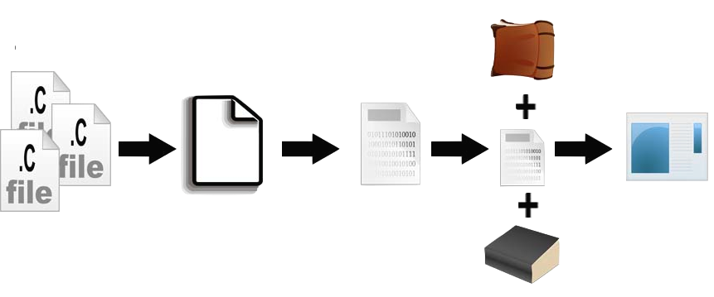
An Overview of Compilation
Standard and Other
Libraries
C++ Source
Code
Files
Temp
File
Object
File
Executable
Precompile
Compilation
Linking

Slide 10
Basic C program
preprocessor directive
#include <stdio.h>
#include <stdlib.h>
int main(){
printf(“Hello World”);
return 0;
}
main function, always start here
printf library function, prints to screen
return statement

Slide 11
C Notes
C is…
whitespace insensitive
x = 2 + y is that same as x=2+y; is the same as: x =2 +y;
Case sensitive
x is not the same as X
‘hello’ does not equal ‘HELLO’

Slide 12
Comments
// -- Single line
//answer to the universe int answer = 42;
/* */ -- Multiple line
/* Haikus are easy But sometimes they don’t make sense Refrigerator */ char answer = ‘C’;

Slide 13
Formatted Printing
You need to include system libraries that contain subroutines for standard input and output
including the "header file" called stdio.h which has the printf subroutine.
printf takes two parameters
Format string
Variable list

Slide 14
printf()
Printf sends formatted data to stdout
The standard output for your machine, usually the console
A format string formats the output based on the data type with format specifiers
Each type has its own format specifier
Some characters have their own format specifier
Newline = \n
Tab = \t
“ = \”

Slide 15
Printf examples
Print an integer
printf(“%d”, 2);
Print a floating point number
printf(“%f”, 2.5);
Print an integer and a string
printf(“%d %s”, 42, “and bring a towel”);
You can print multiple values in a single printf statement as long as their order matches the order of the format string

Slide 16
C Variables
Variable names in C must follow the following rules:
Composed of letters, digits, and underscore
Begin with a letter or underscore (not digits)
Case Sensitive
Must have a data type

Slide 17
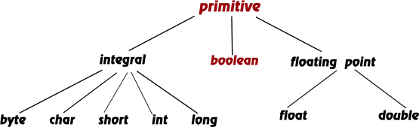
Data Types
Each variable has a type, which tells the compiler how the data is to be interpreted (and how much space it needs, etc.)
C has (technically) unlimited Data types
C has 7 primitive (built in) types
We will only use 4
Integers (whole numbers) int short long unsigned int | Floating point (real numbers) float double | Characters char

Slide 18
Allocating Space for Variables
What happens when you run a program?
OS allocates memory for your program
All variable data is stored within this allocated segment
0x0000
instructions
global data
PC
run-time
stack
0xFFFF

Slide 19
Declaration
When you create a variable, you must declare it first.
Declaration prepares a memory location for the data
DOES NOT contain “nothing”.
Memory retains whatever garbage was previously in that memory location. (Unless the item is declared as “static”.)
You must declare a variable as a type
You can declare multiple variables of the same type on the same line
int x, y, z;

Slide 20
Initialization
Assigns a value to a variable
use ‘=’ to assign a value
Example: char letter = ‘z’;
use single quotes around letters
Overrides existing value
There is always an existing value because declaring does not ‘clear’ memory
Type of a variable cannot be changed
Even if assigned another type
All statements end with a semicolon

Slide 21
Casting
What if you you want to assign the value of a variable to another variable of a different type?
You must cast it.
Casting forces the compiler to interpret the binary as a different type
char c = ‘A’; int x = (int) c;
Syntax <type> new_var = (<type>) old_var;

Slide 22
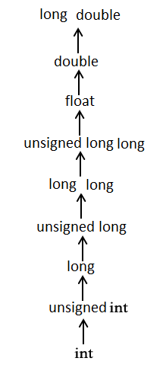
Logical vs Literal conversion
Type promotion enables automatic logical conversions for certain type conversions
implicit
Performed by the compiler to create equivalent values
explicit
The raw bit representation of the source is copied verbatim, and it is re-interpreted according to the destination type.

Slide 23
Problems with Casting
This does not change the type of the old variable (or memory location)
When casting from a larger type (like an int) to a smaller type (like a char), you may lose data.
int (size depends on machine architecture at compile time)
32, 64 bits
char ALWAYS = 8 bits
C trusts you to know what you are doing
Example: char c = (char) 256;
results in tab character

Slide 24
Arithmetic Expression
If mixed types, smaller type is "promoted" to larger.
x + 4.3
if x is int, converted to double and result is double
Integer division -- fraction is dropped.
x/3
if x is int and x=5, result is 1 (not 1.666666...)
Modulo -- result is remainder.
x%3
if x is int and x=5, result is 2.

Slide 25
Special operators: ++ and --
Changes value of variable before (or after) its value is used in an expression.
Symbol Operation Usage
++ postincrement x++
-- postdecrement x--
++ preincrement ++x
-- predecrement --x 3
Pre: Increment/decrement variable before using its value.
Post: Increment/decrement variable after using its value.

Slide 26
Boolean Expressions
Expressions that resolve to True or False
== equal to != not equal to < less than > greater than <= less than or equal to >= greater than or equal to | && AND II OR
In C:
0 == FALSE
Anything other than 0 == TRUE

Slide 27
Arrays
An array is a list of items that are all the same type
It is a static entity
same size throughout program
size is determined at compile time
4 | 36 | 14 | 1 | 22

Slide 28
Declaration of Arrays
When declaring arrays, specify
Variable Name
Type of array
Number of elements
type array_name[ num_elements ];
Examples:
int c[ 10 ];
float my_array[ 3284 ];

Slide 29
Definition of Arrays
Several ways to initialize
int n[ 5 ] = { 1, 2, 3, 4, 5 };
If not enough initializers, rightmost elements become 0
int n[ 5 ] = { 0 }
All elements 0, e.g. n = [0][0][0][0][0]
If too many a syntax error is produced

Slide 30
Refer to an element
int list[4] =
The individual elements of an array are assigned unique subscripts.
These subscripts are used to access the elements.
Arrays are 0 indexed
???
???
???
???
0
1
2
3
0
0
0
0

Slide 31
Refer to an element
Referencing an array element requires:
Array name
Position number
Example:
list[3]
3
0
0
0
0

Slide 32
Array Size
An array size is the total size of the array in bytes / the size of the type
Determine the size of an array with sizeof
sizeof(list)/sizeof(type)
sizeof is an operator that gives you the size in bytes of an element

Slide 33
Character Array
Referred to as a string
string type is ‘char[ ]’
example: char hello[] = {‘H’,‘e’,‘l’,‘l’,‘o’}
For your convenience: char[] hello = “Hello”
Where’s the end of a Character Array?
Strings always end in a null byte
NULL byte = ‘\0’ // also 0
char hello[] = {‘H’, ‘e’, ‘l’, ‘l’, ‘o’, ‘\0’};
Implicit when using shorthand
char hello[] = “Hello”; // the ‘\0’ is added by compiler
Sizeof(hello) is SIX (one space for the \0)

Slide 34
Classwork
tbd
Arrays

Slide 35
Bounds Checking
Bounds: the start and end of the array
If size omitted, initializers determine the bounds
int n[ ] = { 1, 2, 3, 4, 5 };
5 initializers, therefore 5 element array
C arrays have no bounds checking
For array of length 5, n[5] will return a value, but it’s WRONG to do this

Slide 36
Arrays as Parameters
Arrays as parameters to functions don’t need a size
Why not?
For function foo that takes an array as a parameters the following is sufficient
int foo(int array[]){ … return array[0]; }

Slide 37
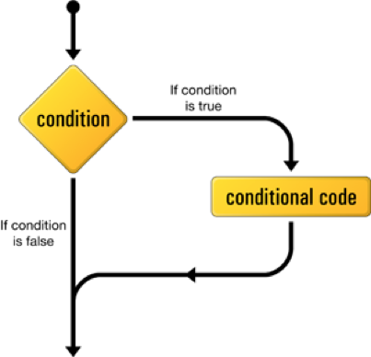
If Statement
‘if’ is a reserved word
Syntax:
if(<boolean expr>){
//code
}
Example:
if( x >= 1)

Slide 38
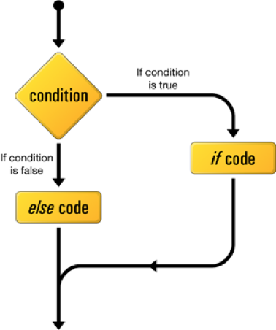
else Statement
‘else’ is a reserved word
Syntax:
if(<boolean expr>){
//code
}else{
//code
}

Slide 39
else if Statement
Syntax:
if(<boolean expr>){
//code
} else if(<boolean expr>){
//code
}

Slide 40
Common Error
What happens if you write?
int var = 5; if(var = 1) var++; printf(“%d”, var);
Everyone makes this error. I still do.

Slide 41
Block Statements
Several lines of code can be grouped together into a compound block statement
A compound block is usually delimited by braces
{ … } can contain one or more standard C executable statements.
Always indent nested blocks.
Indentation means nothing to the computer – only to a human reader!!!

Slide 42
Repetition Statement
Repetition statements allow us to execute a statement multiple times
Like conditional statements, they are controlled by boolean expressions

Slide 43
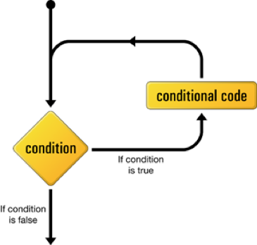
While Loop
while(<boolean expr>){
//do stuff
}
If the condition is true, the statement is executed
The statement is executed repeatedly until the condition becomes false

Slide 44
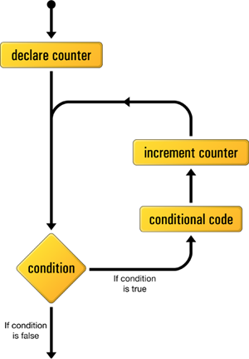
For Loop
A special kind while loop
for(int i = 0; i < 10; i++ ){
//do stuff
}
Syntax:
for(<define index>; <conditional>; <alter counter>)

Slide 45
Classwork
int i, j;
for (i=1; i<100; i++) {
int prime=1;
for (j=i-1; j>1; j--){
if (i % j == 0){
prime=0;
break;
}
}
if(prime) printf("%d\t", i);
}
return 0;
Prime Numbers

Slide 46
What are Functions?
Function Definition
A collection of actions that may or may not return a value
Kinds of functions
Library (printf, pow)
User defined
Analogy:
Give ingredients for cookies to baker
Baker returns cookies
Eat cookies without caring how they were made

Slide 47
Declaration of a Function – the prototype
Function Definitions require:
return type
name (Use mixedCase)
parameters
Example:
int foo(int var);
double pow( double base, double exponent );
<returnType> <functionName>(<parameter1>,, <parameter2>,, …)

Slide 48
Return Values
Can return any single valid type:
return_type functionName(type parameter){ //do stuff return value; }
Can also return nothing: ‘void’
void functionName(type parameter){ //do stuff return; //this isn’t required for a void function }

Slide 49
Return Values
Can return a value from anywhere
int functionName(int p){ if(p == 0){ return 5; }else{ return 10; } }
Once you return a value, the function stops executing

Slide 50
Functions need to be declared
Functions take up memory, and anything that takes up memory requires declaration before being used
The compiler must know how much memory it will need
You can declare and define a function simultaneously
int add_ints(int x, int y){ return x + y; }

Slide 51
Functions need to be declared before used
Just like variables, you can declare and define a function separately
int add_ints(int x, int y); //your brilliant code... int add_ints(int x, int y){ return x + y; }

Slide 52
Classwork
#include <stdio.h>
void printPrimes(int limit){
int i, j;
for (i=1; i<limit; i++) {
int prime=1;
for (j=2; j<i; j++){
if (i % j == 0){
prime=0;
break;
}
}
if(prime) printf("%d\n", i);
}
}
void inc(int num){
printf("%d\n", num++);
}
int main(){
int x = 50, i;
printPrimes(x);
for(i = 0; i < 3; i++){
inc(x);
}
return 0;
}
Functions and Scope

Slide 53
Parameters are copies
In C, all parameters to functions are always copies of the value passed
This is called ‘Pass by Value’
Any changes made to function parameters only exist for the scope of the function

Slide 54
Arguments and Scope
Variables are only valid within their scope and nested scopes
Scope can be defined by the braces, everything between the braces is a scope
Each function has its own scope
Can create a nested scope with { }
Global Scope is accessible anywhere
int A;
int B = 5;
int foo(int A){
int B;
return A+1;
}
int bar(int A){
B = foo(A);
printf(“%d”, B);
}
//What prints when bar(6) is called?
Global
Local

Slide 55
Local Variables Disappear with scope
Variables created within a scope disappear when the program leaves the scope
Example:
void foo(){ int x = 2; }
After returning from foo(), ‘x’ no longer exists

